Slide 1
Advanced Image Analysis
a.a. 2017-2018, 2nd semester
Project
Mass Segmentation in Digital Mammograms
Alessandro Bria
Contract Professor
and Post-doc Researcher
email: a.bria@unicas.it

Slide 2
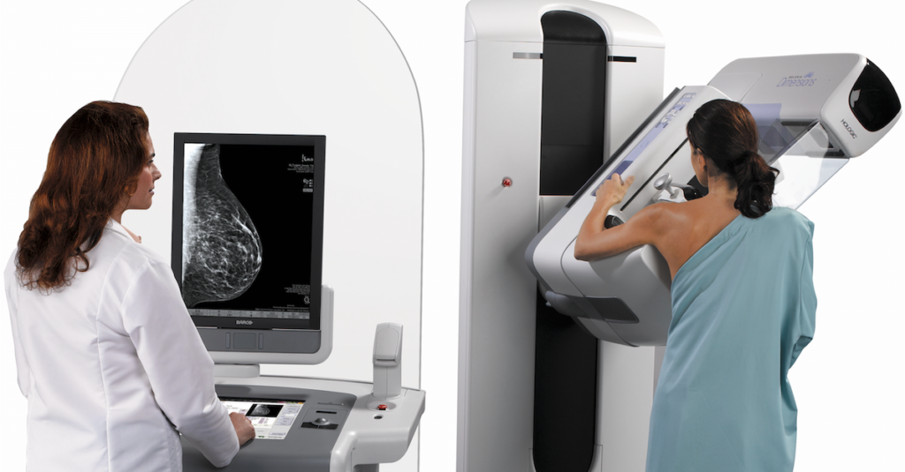
Motivations
X-ray mammography is a widely used method to screen women for early detection of breast cancer
Computer Aided Diagnosis (CAD) helps radiologists in interpreting screening mammograms
the two most important lesions that may be present on a mammogram are microcalcifications and masses
CAD often consists first in detecting the lesions and then classifying them into benign / malignant

Slide 3
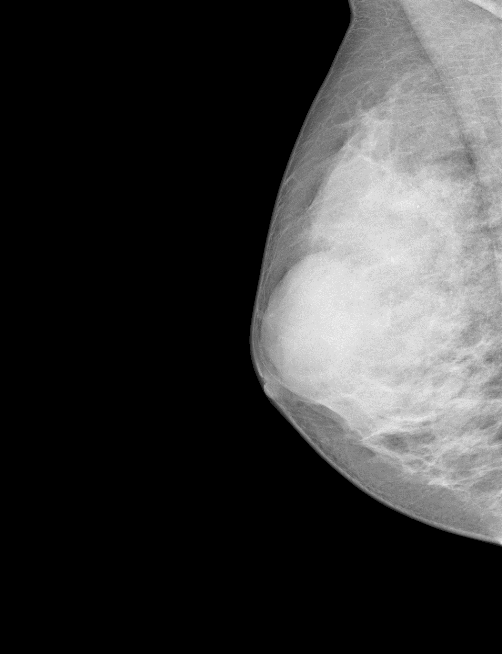
Goal
implement a reusable module for automated Mass Segmentation
a must-have module in most CAD systems
Mass Segmentation
microcalcification detection
pectoral muscle segmentation
...
input images
CAD system
binary images

Slide 4

Materials
INBREAST dataset (410 images) containing:
mammograms (16-bit)
/dataset/images
breast-air masks
/dataset/masks
manual annotations
/dataset/groundtruths

Slide 5
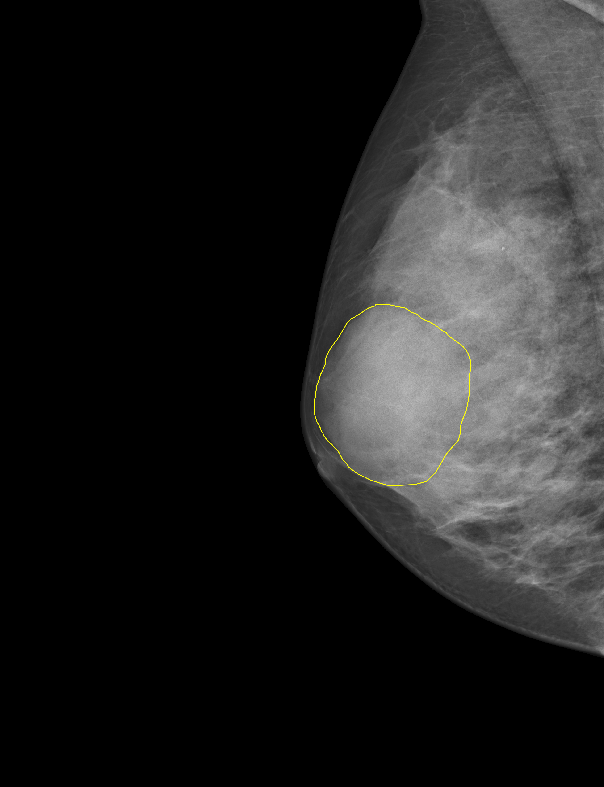
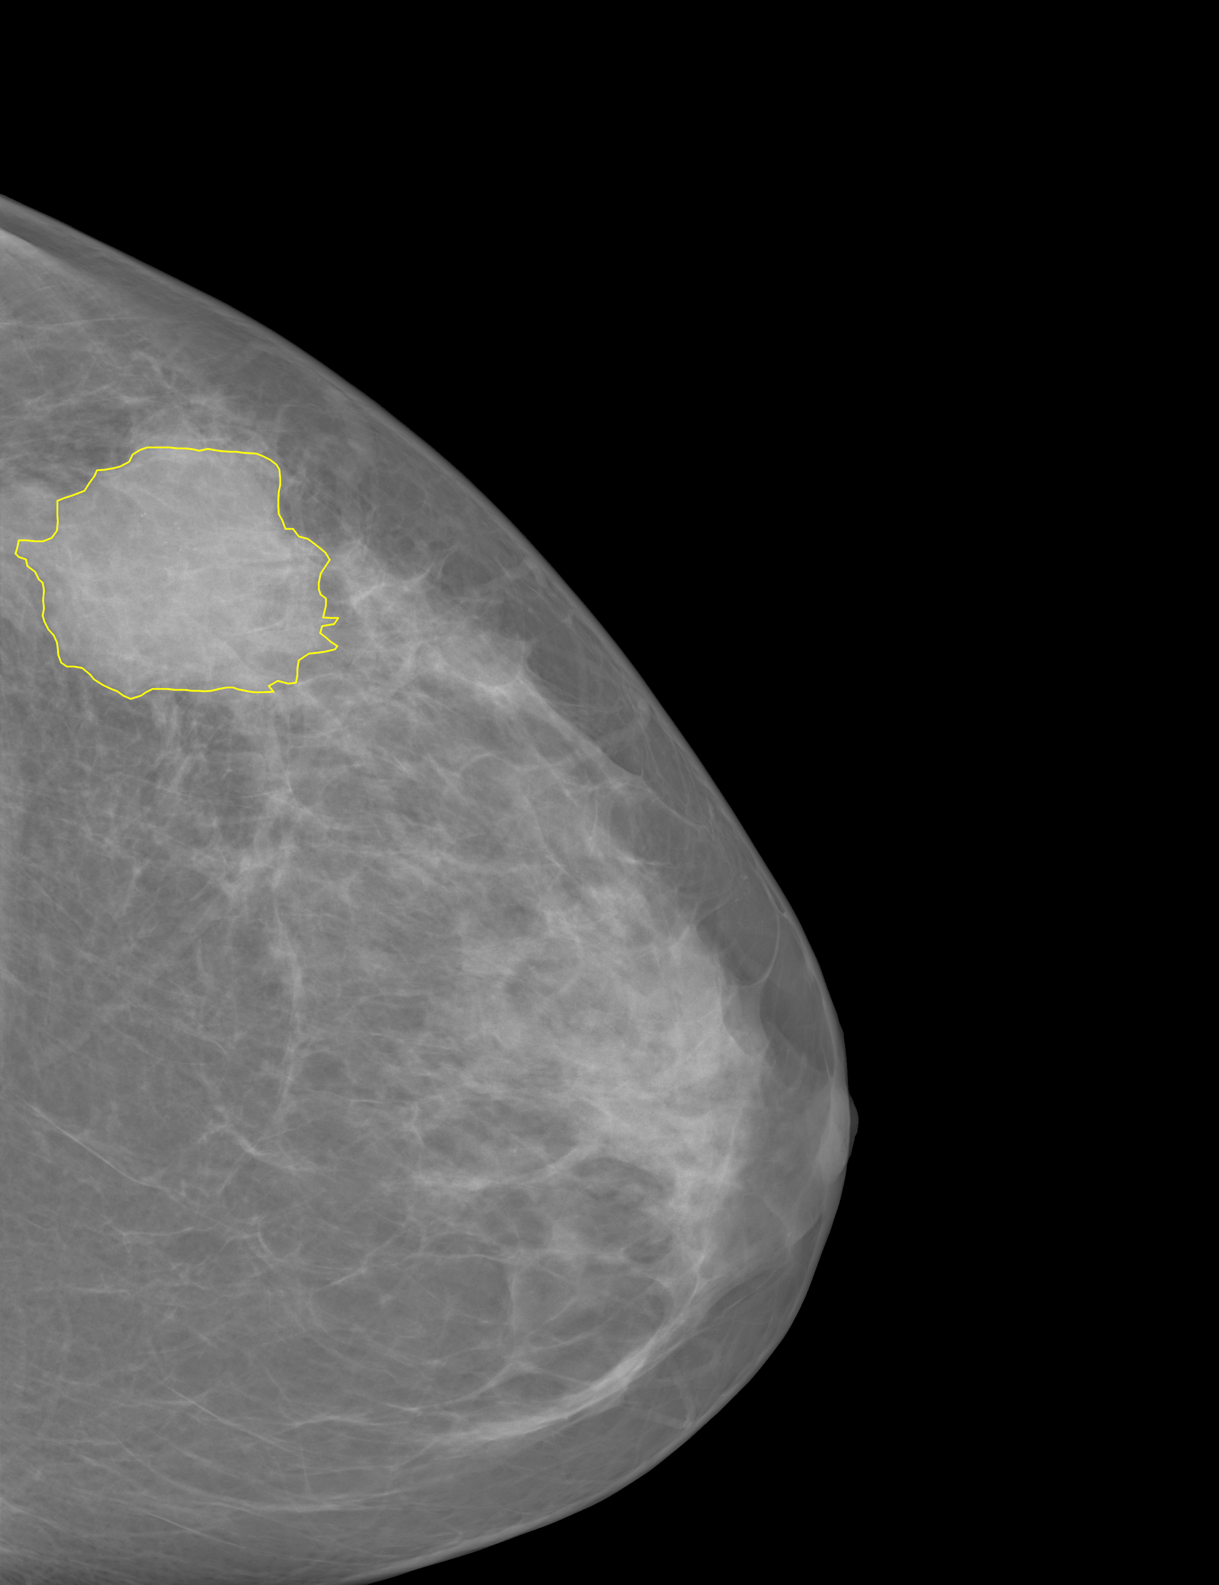
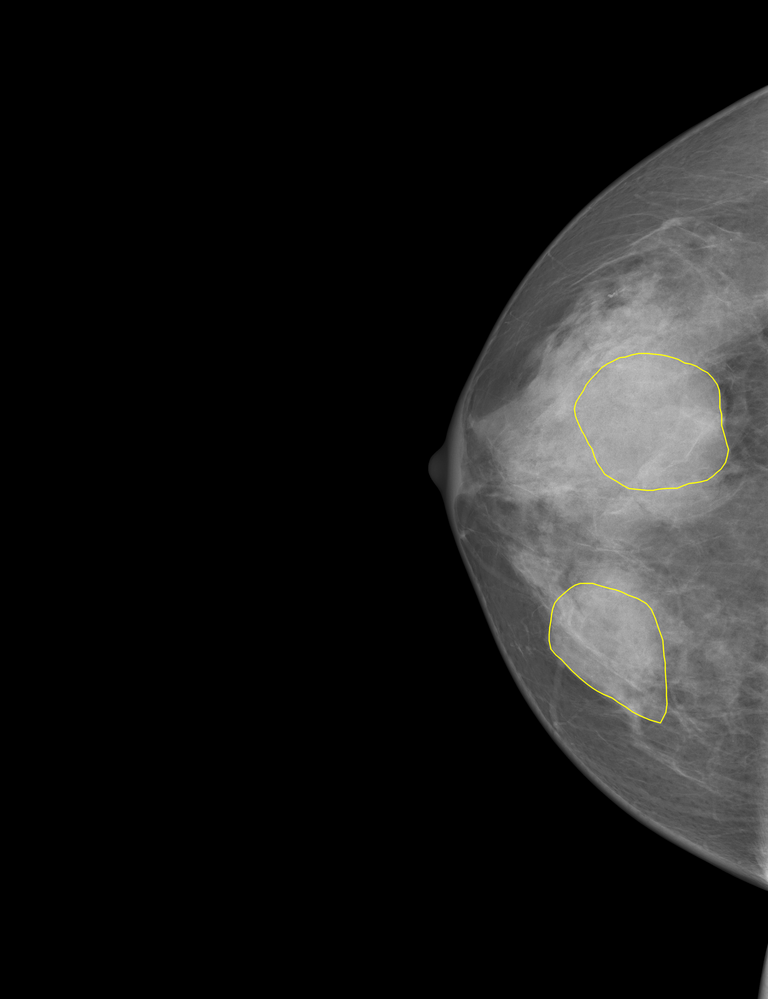
Materials
warning: among the 410 images, only 107 contain masses (positive images)
there are only 107 manual annotations in the /dataset/groundtruths folder
see also the 107 overlayed annotations in the /dataset/overlay folder

Slide 6
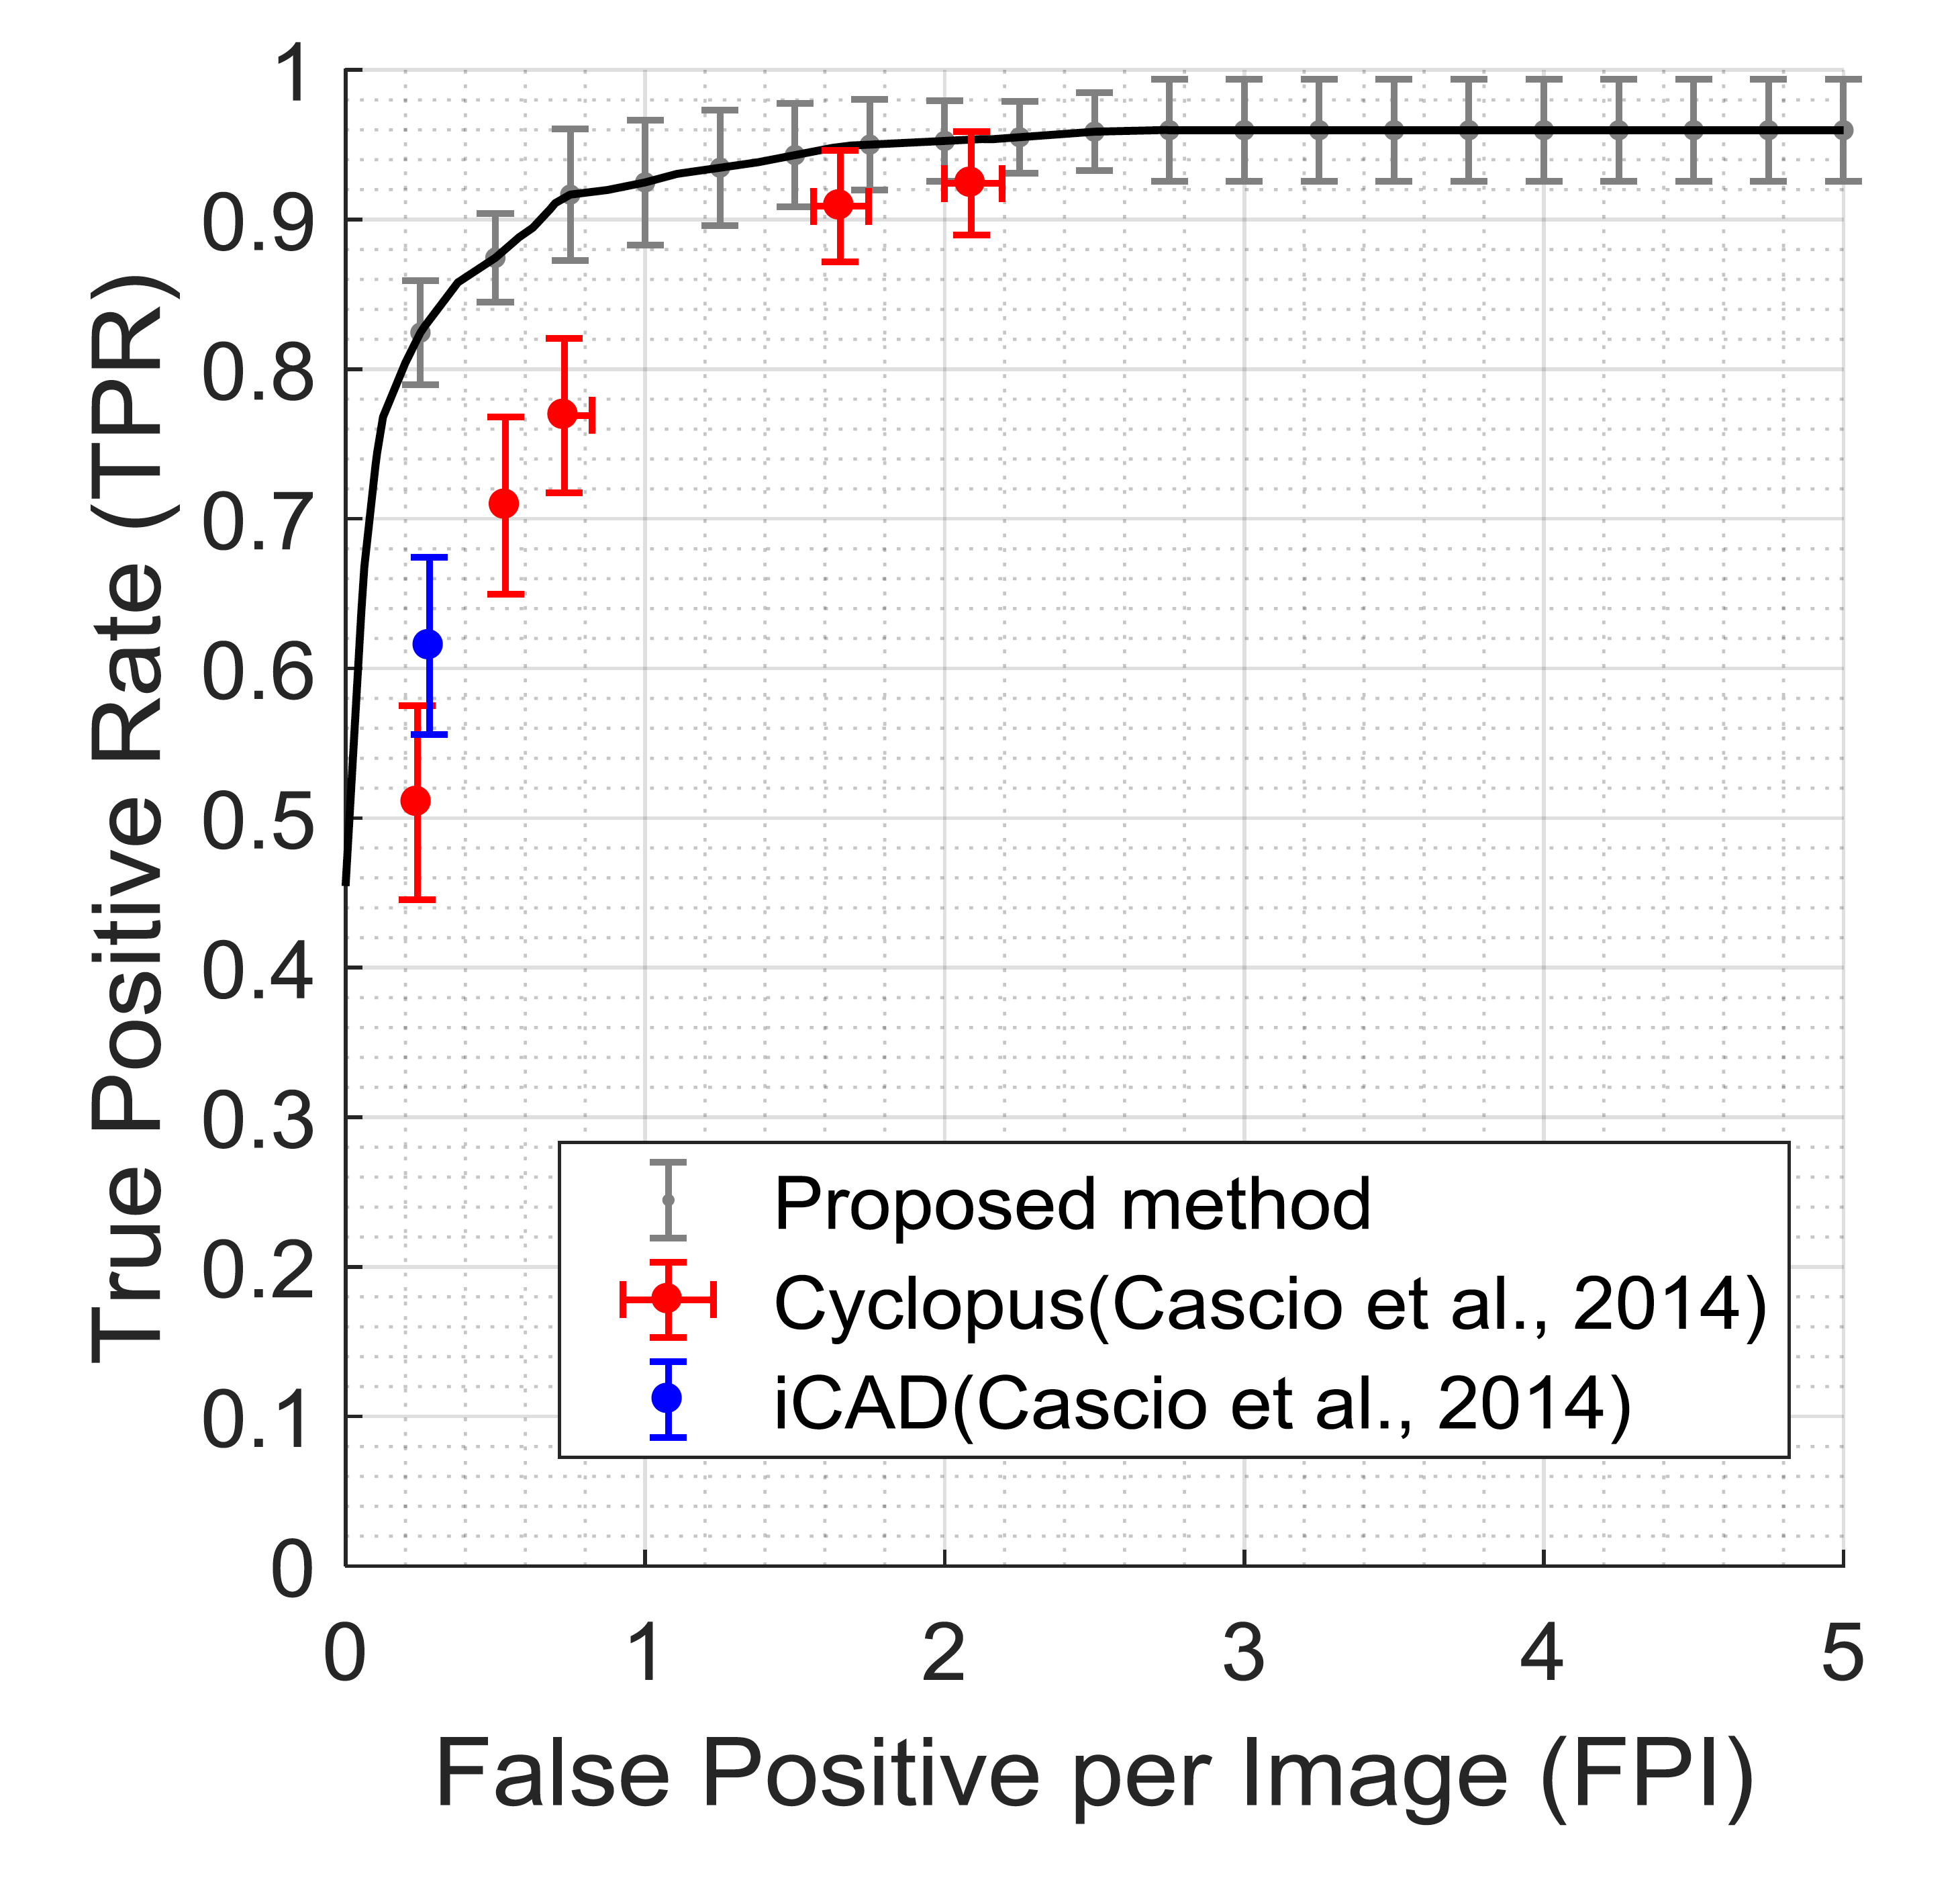
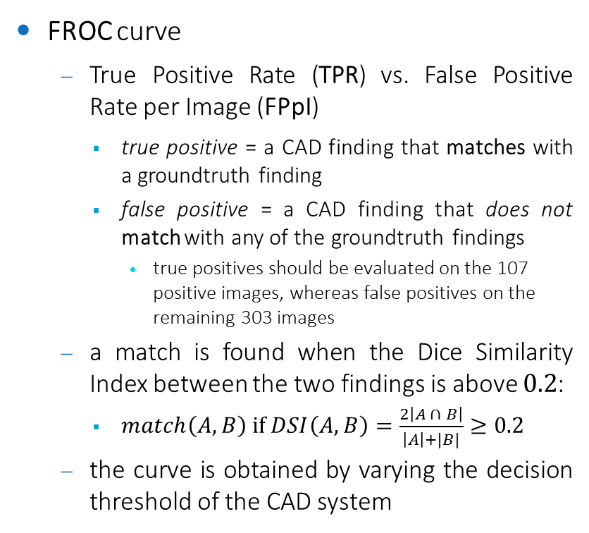
Performance evaluation
FROC curve
True Positive Rate (TPR) vs. False Positive Rate per Image (FPpI)
true positive = a CAD finding that matches with a groundtruth finding
false positive = a CAD finding that does not match with any of the groundtruth findings
true positives should be evaluated on the 107 positive images, whereas false positives on the remaining 303 images
a match is found when the Dice Similarity Index between the two findings is above $0.2$:
$match\left(A,B\right) if DSI\left(A,B\right)=\frac{2\left|A ∩ B\right|}{\left|A\right|+|B|}≥0.2$
the curve is obtained by varying the decision threshold of the CAD system
publication zone

Slide 7
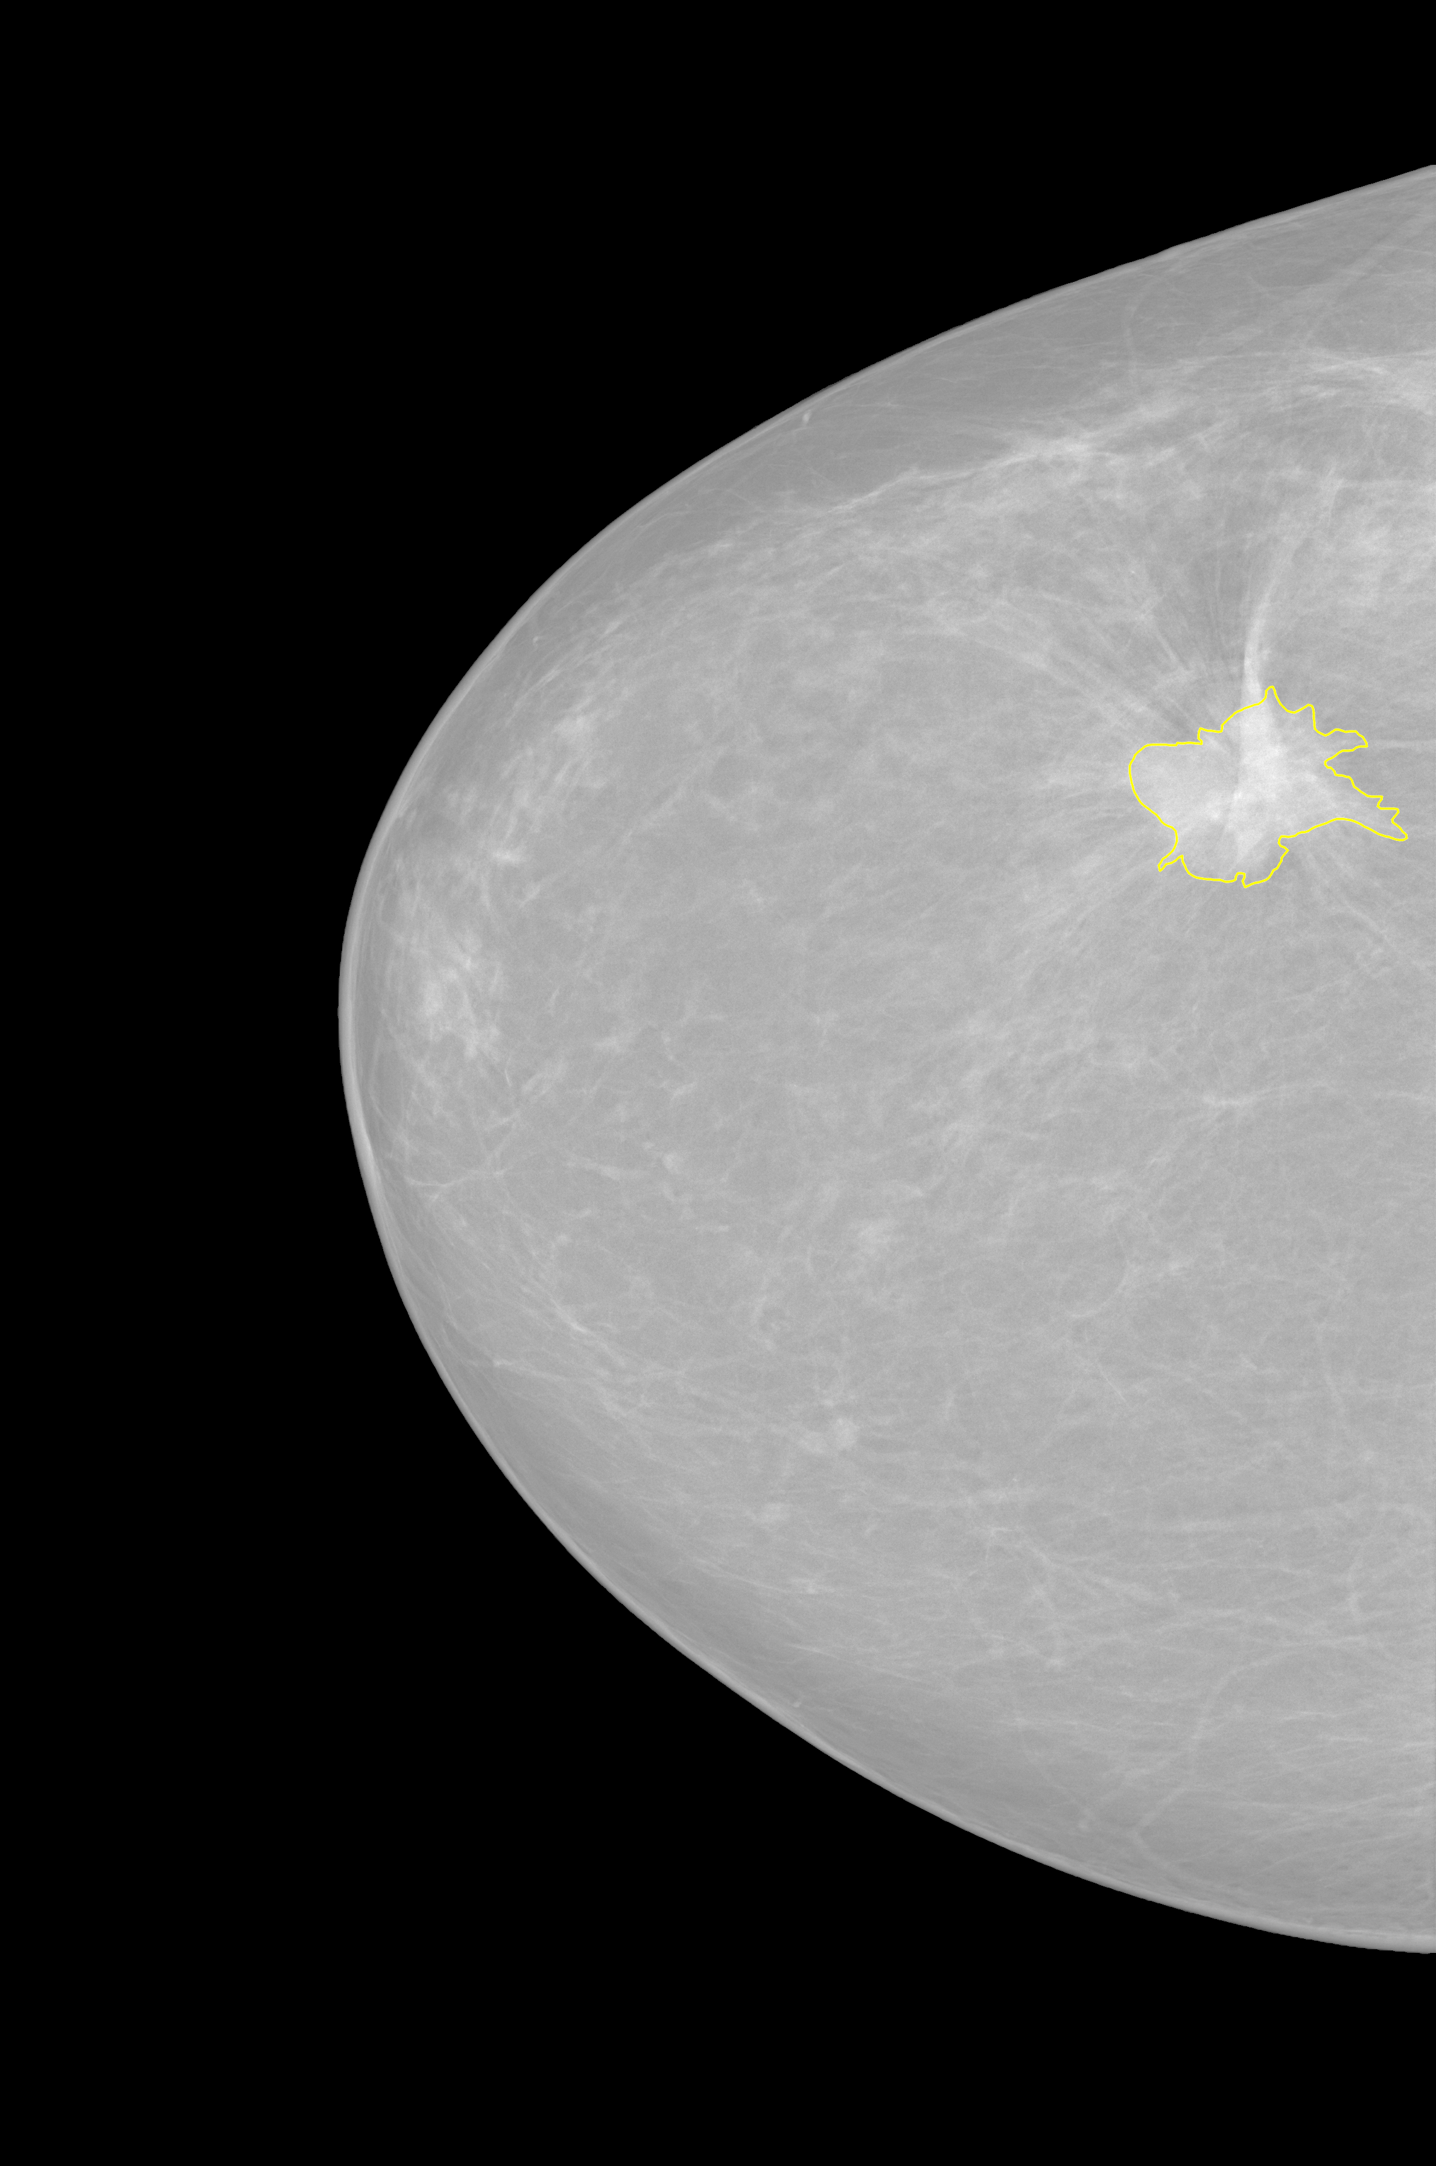
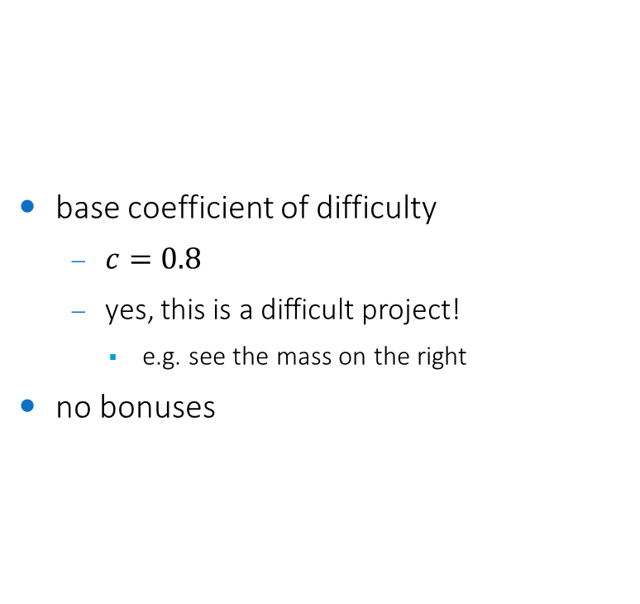
Coefficient of difficulty
base coefficient of difficulty
$c=0.8$
yes, this is a difficult project!
e.g. see the mass on the right
no bonuses

Slide 8
Constraints
implementation in any language/framework
C++/OpenCV suggested for extracting the mass candidates / features (but not mandatory)
reusable module
the code must be commented
same parameters for all the images
unless parameters are automatically-adjusted on each image
machine learning
highly recommended
use the first half of the dataset for testing, and the second half for training
then switch testing with training, and merge the results (2-fold cross-validation)

Slide 9
Code snippets
how to calculate the Dice Similarity Index?
adapt and modify /code-snippets/compute-segmentation-accuracy.cpp
how to load all images within a folder w/o knowing their file names?
see /code-snippets/load-all-images-within-folder.cpp

Slide 10
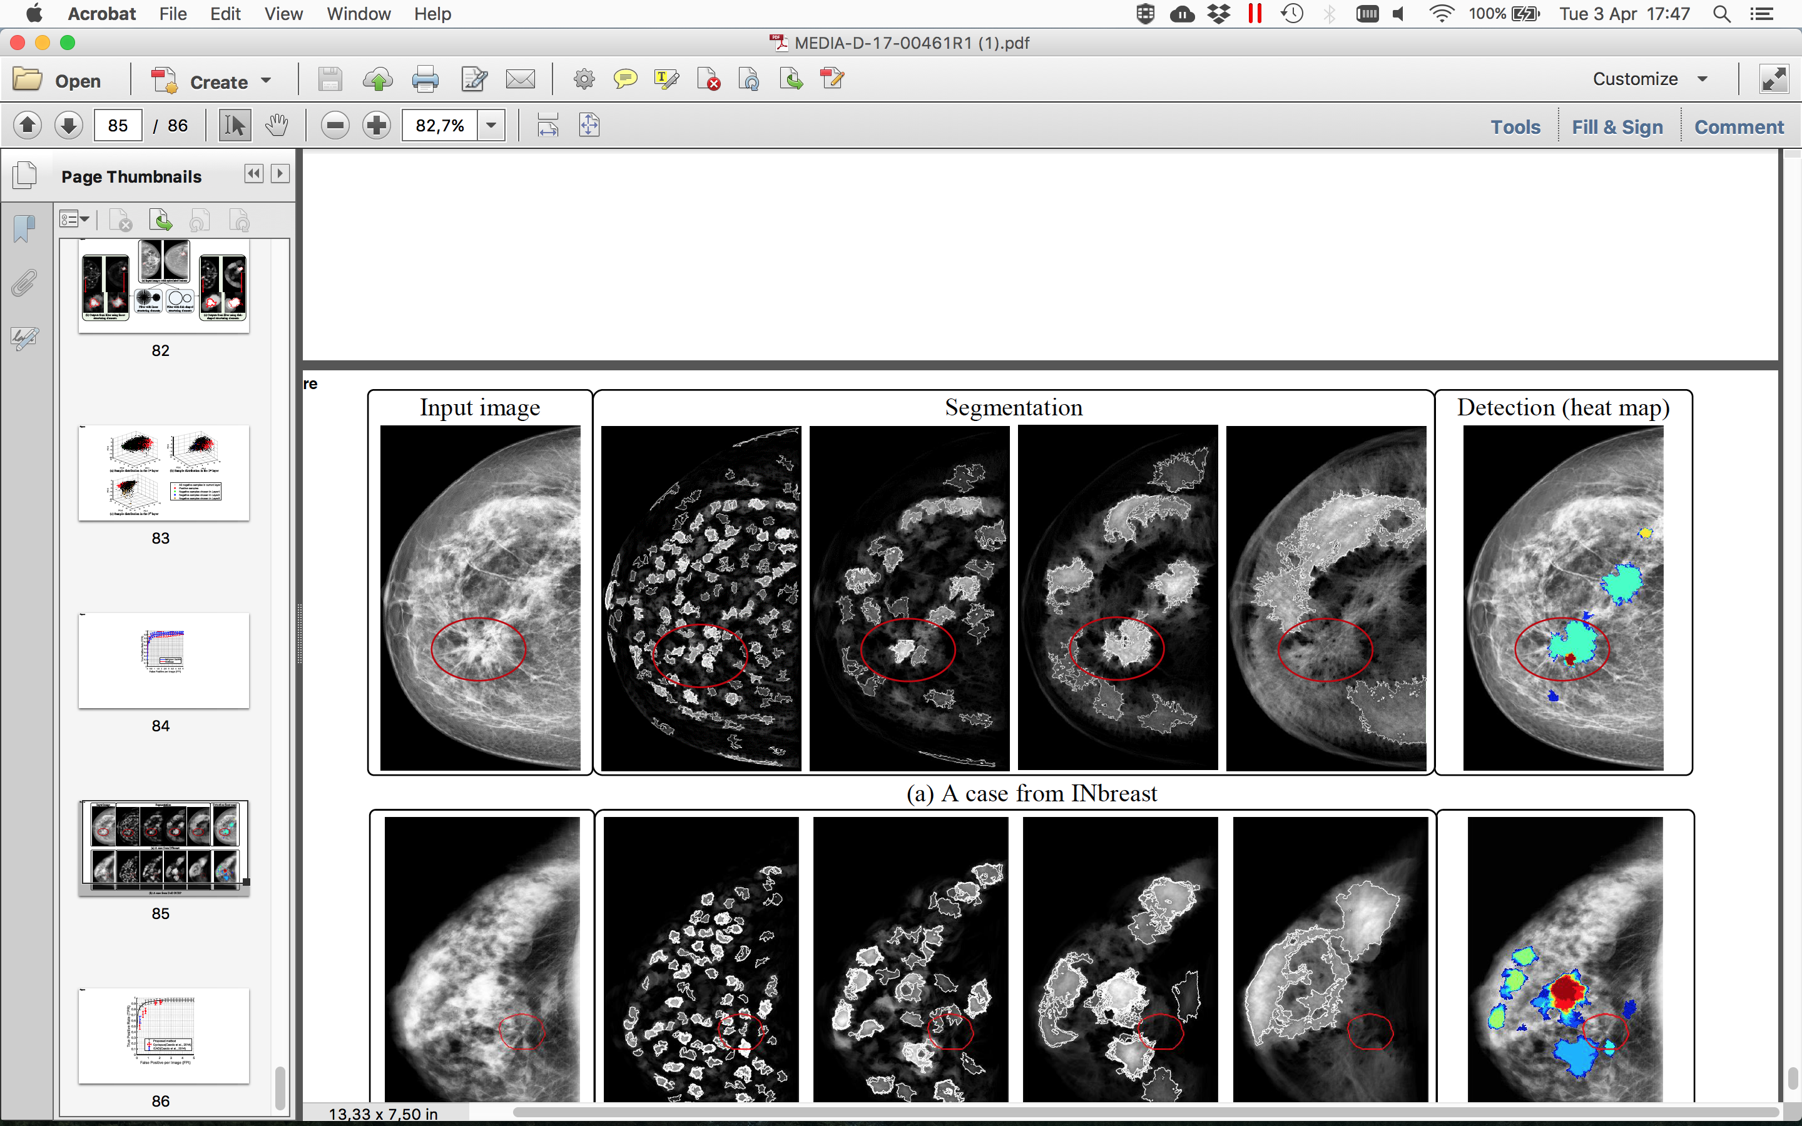
Hints
top-down approach
preprocessing
e.g. contrast enhancement with one of the techniques learnt from Image Processing
mass candidate extraction
e.g. oversegmentation with one of the techniques learnt from AIA
feature extraction
extract a set of meaningful features from each mass candidate (features learnt from AIA + others)
classification
use machine learning (SVM, Boosting, Random Forest, ... others learnt from Pattern Recognition) to classify candidates into masses and nonmasses

